Slide 1

The Game of moocs
Dr. Charles Severance
University of Michigan School of Information
E-LEARN 2015 – World Conference on E-Learning
21-October-2015
Notes:
Games on many levels, higher education, University of Michigan.
Approaching my millionth student.

Slide 2
The Short Version of This Talk
Universities around the world are very busy using various types of involvement in the MOOC movement as a way to reimagine how teaching is done and what it means to teach.
The results for most organizations involved so far are nearly all positive.
Notes:
It is not about transforming education – but it will transform education. Negative consequences are limited to the weak and marginal.

Slide 3

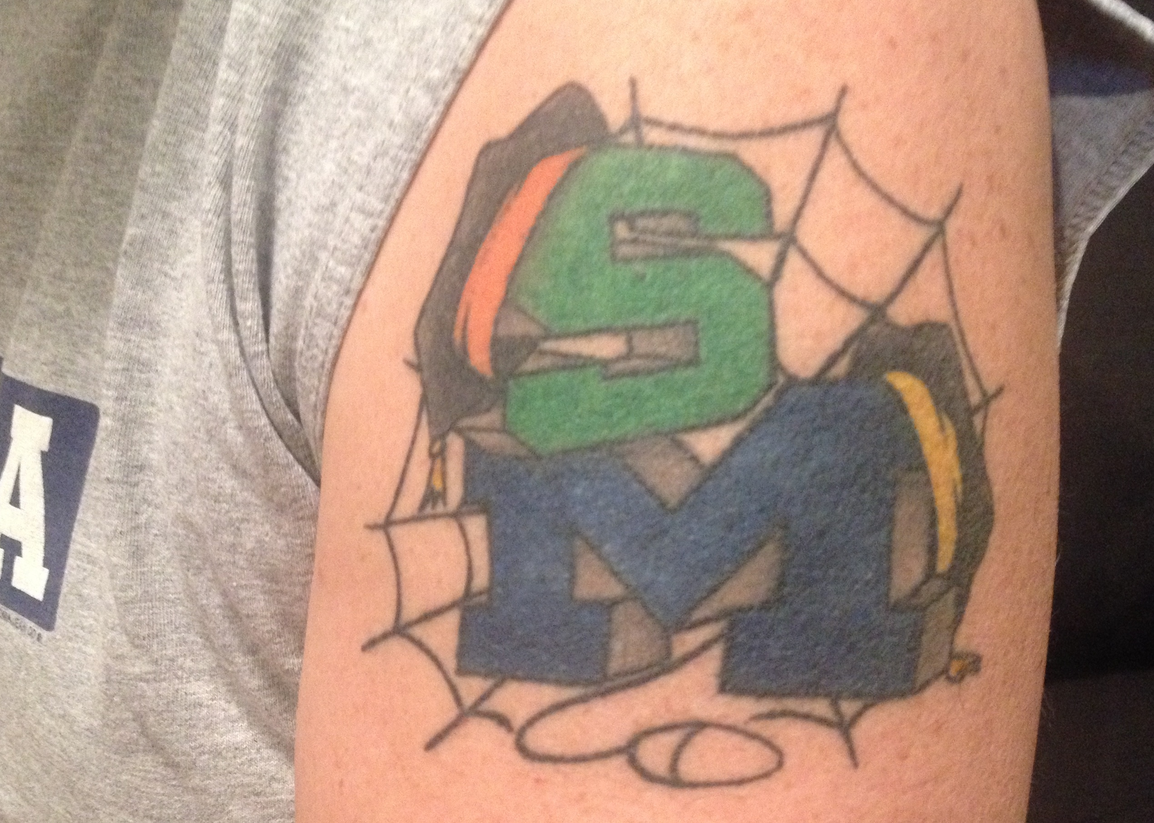

Slide 4
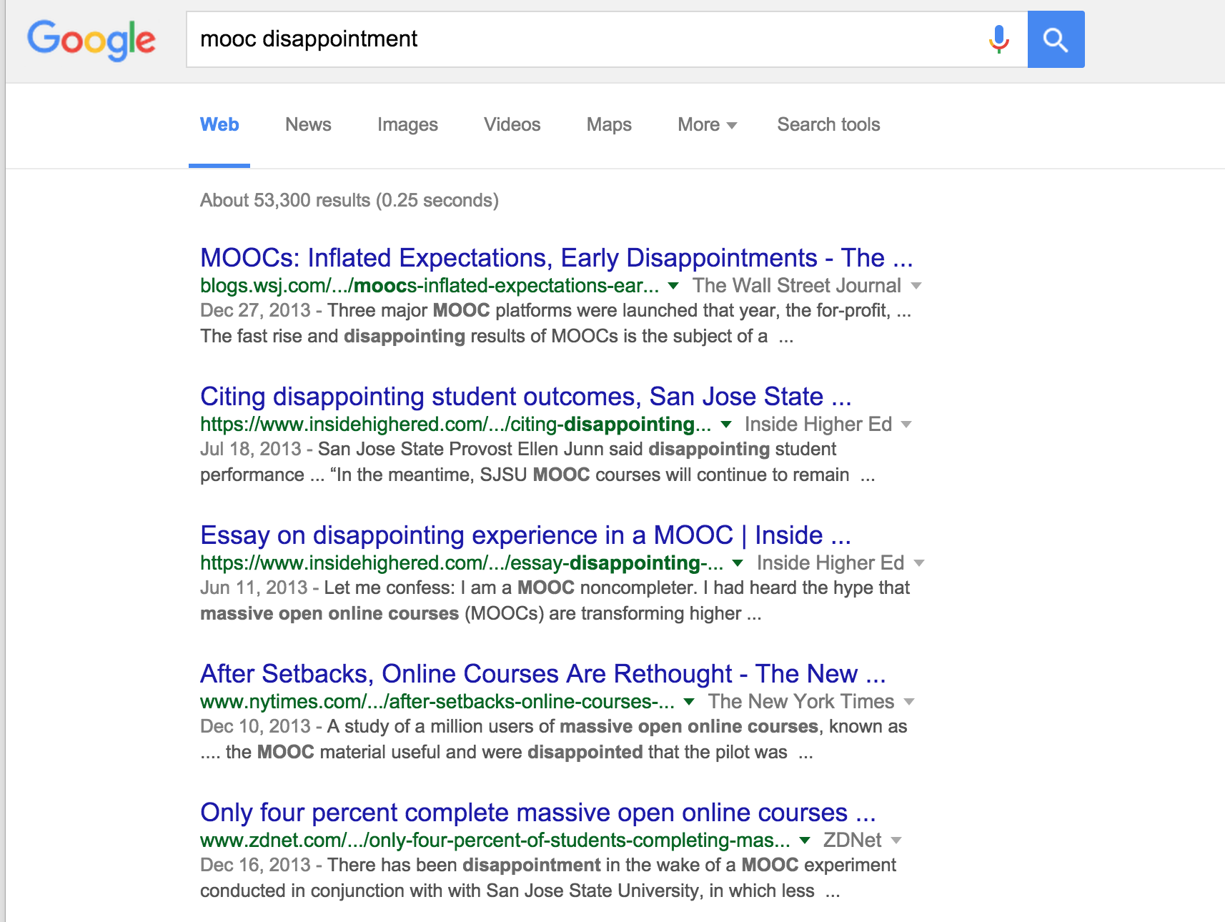
Notes:
The times they are a changing.

Slide 5
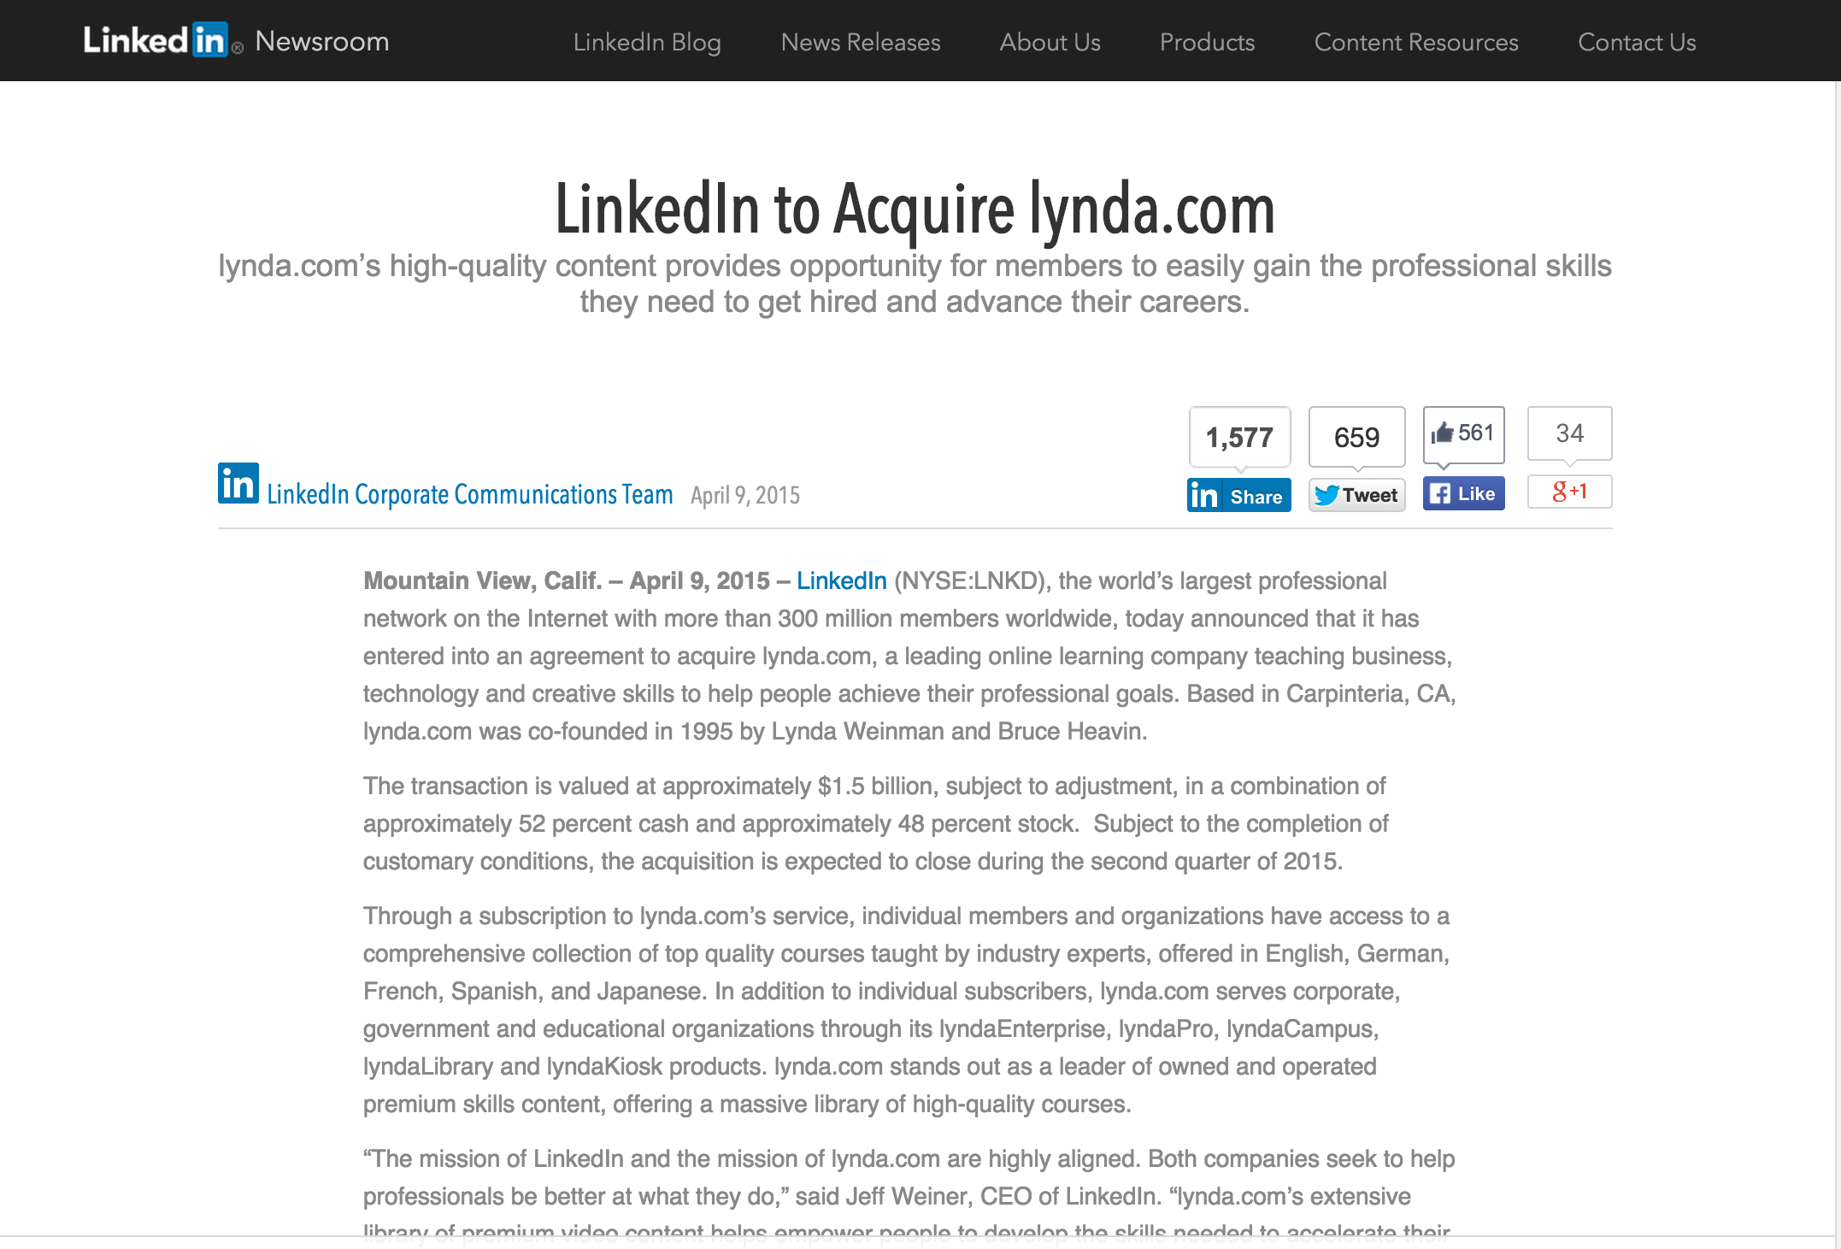
https://press.linkedin.com/site-resources/news-releases/2015/linkedin-to-acquire-lyndacom

Slide 6

Notes:
Founding member of Coursera. It is a responsibility of a public university to lead and define this new space, 40 courses 15 faculty 15 Support Staff galvanizing education research on campus Learning Analytics Pedagogy

Slide 7
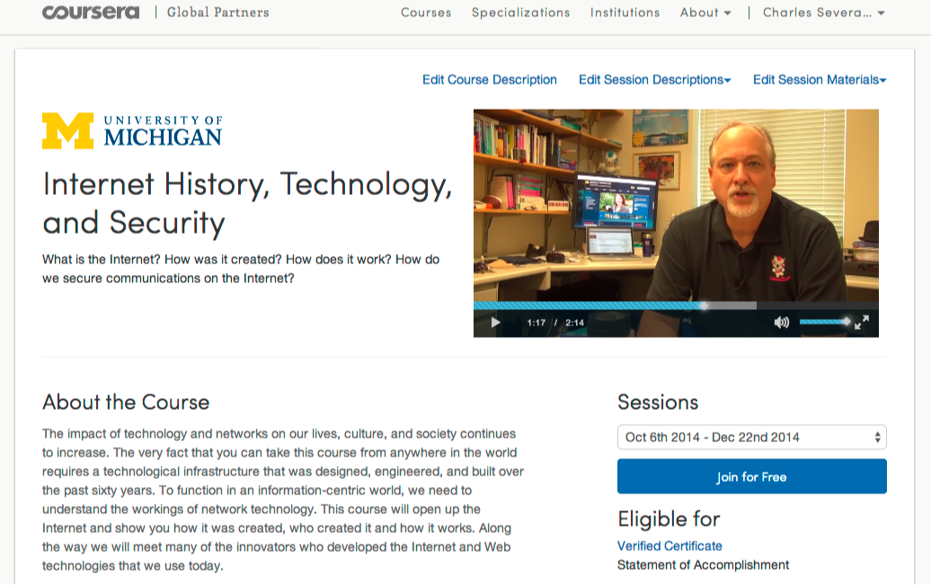
https://www.coursera.org/umich

Slide 8

https://www.edx.org/school/michiganx
Notes:
Committed to 20 course in two years.ßß

Slide 9
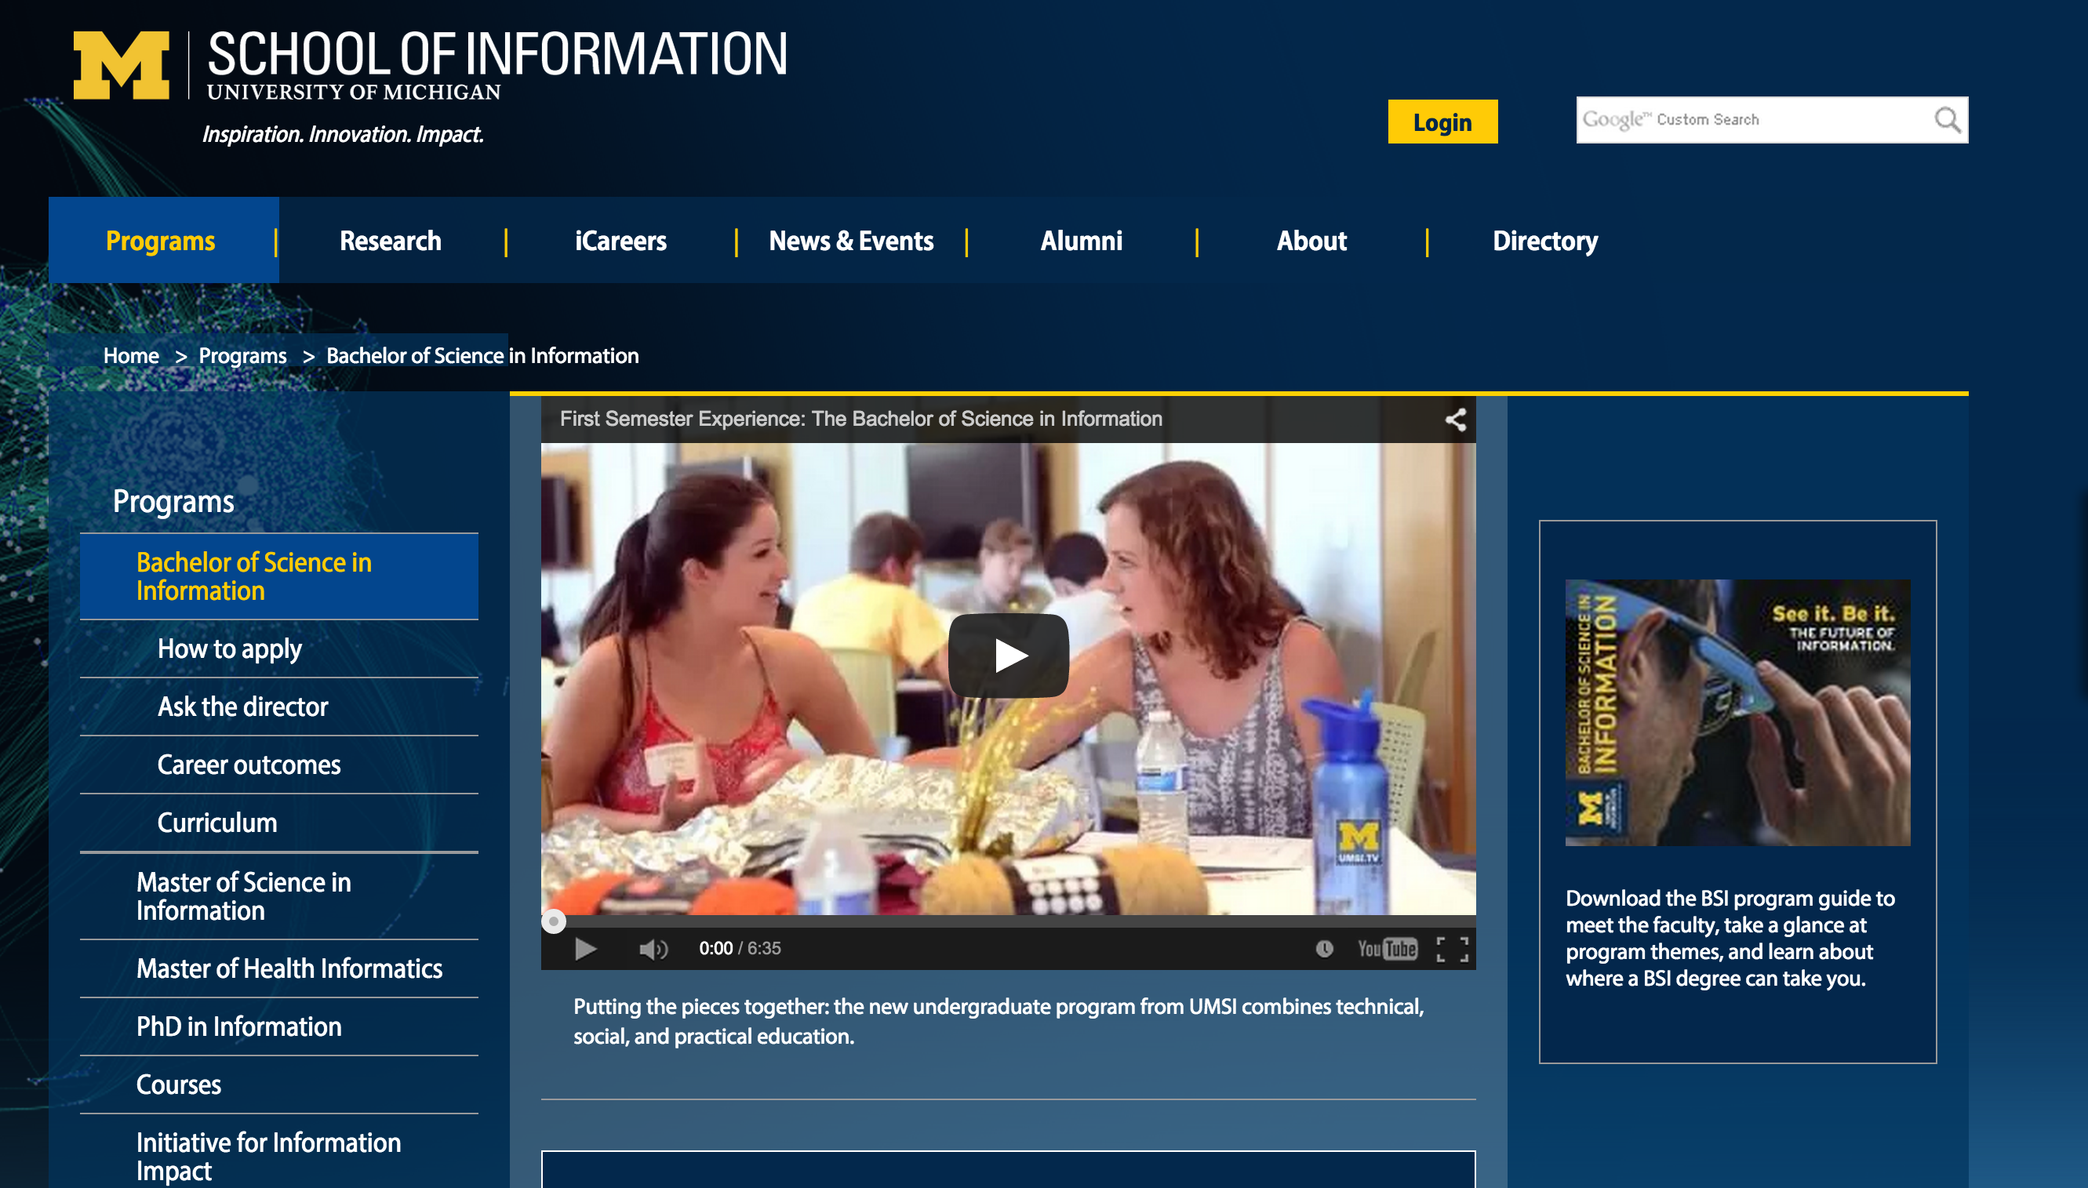
Python, R, JavaScript, Java, PHP, SQL, Swift, ObjectiveC. Statistics, Visualization, Economics, Game Theory, Motivation, Network Analysis, Data Mining...
Notes:
Evaluation, Design and Implementing Technology systems BSI, Python, R, JavaScript, Java, PHP, SQL, Swift, ObjectiveC. Statistics, Visualization, Economics, Game Theory, Motivation, Network Analysis.

Slide 10
Python, R, JavaScript, Java, PHP, SQL, Swift. Statistics, Visualization, Economics, Game Theory, Motivation, Network Analysis, Data Mining, Design, Evaluation ...
Notes:
2015 – 57% women

Slide 11
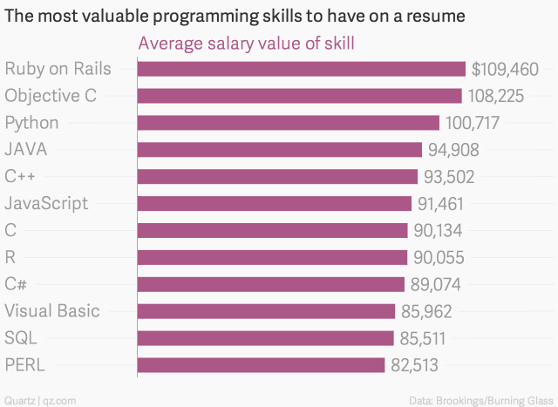
http://qz.com/298635/these-programming-languages-will-earn-you-the-most-money/

Slide 12
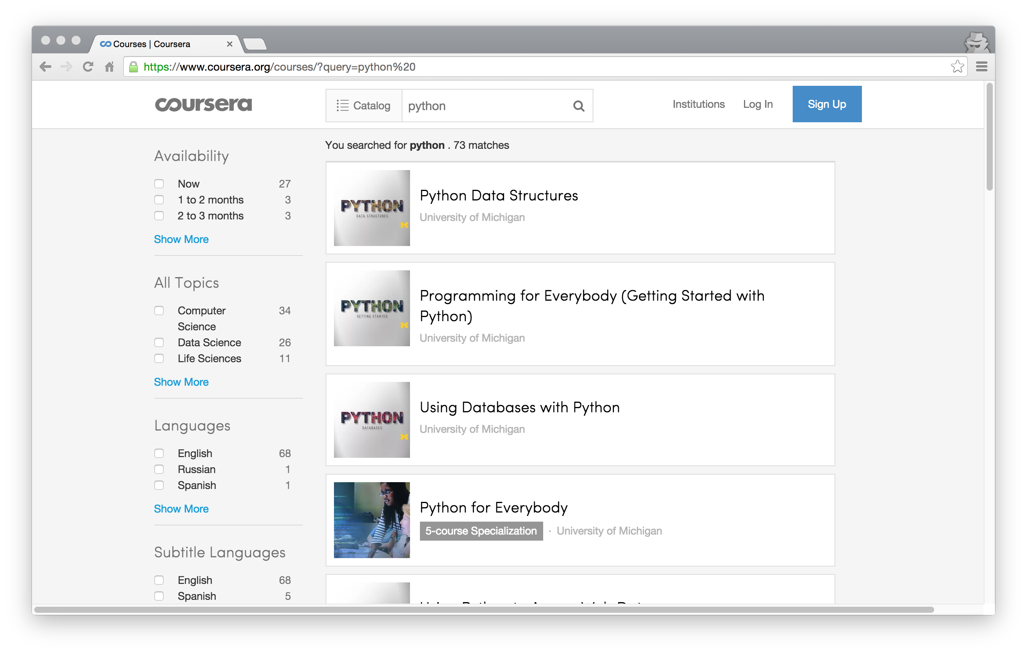
>15 Million Students

Slide 13
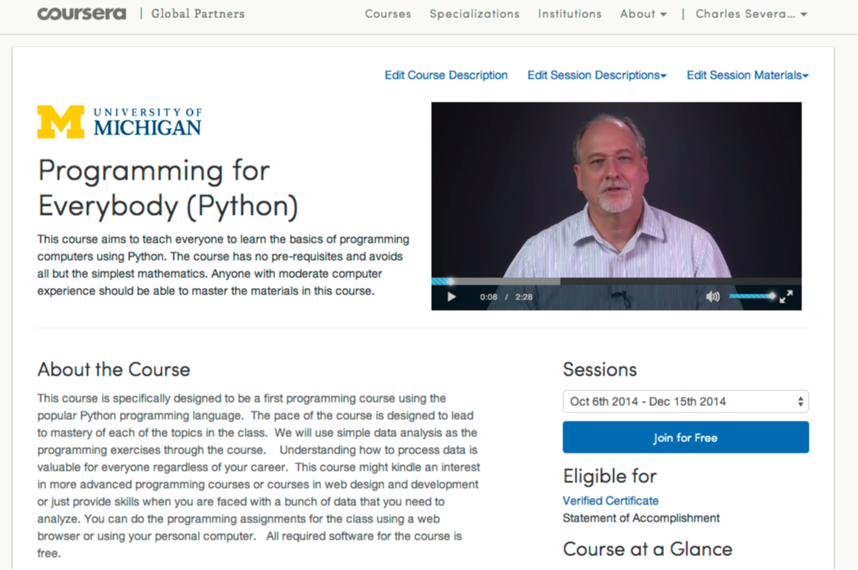

Slide 14
750,038 Total Enrollment
> 450K Revenue

Slide 15

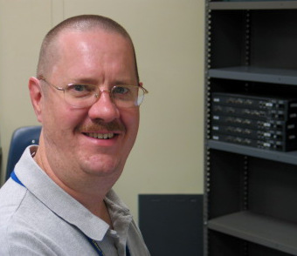
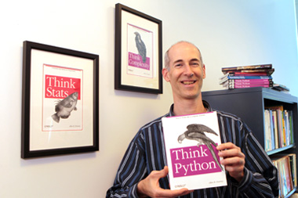
A Free Book
www.pythonlearn.com
Notes:
Average about 400/month

Slide 16
New York, Los Angeles, Ann Arbor, Chicago, Washington DC, Memphis, Seattle, Seoul, Barcelona, London, Mexico City, Amsterdam, Manila Melbourne, Perth...
office-hours.dr-chuck.com
Notes:
Since I have a very active travel schedule, I decided to hold office hours in the major cities I have visited in the past 18 months. I have held office hours in over 15 cities and in each location somewhere between two and 15 students show up.

Slide 17
Lead Community Teaching Assistants
Sue (CA)
Mauro (Italy)
voices.dr-chuck.com

Slide 18
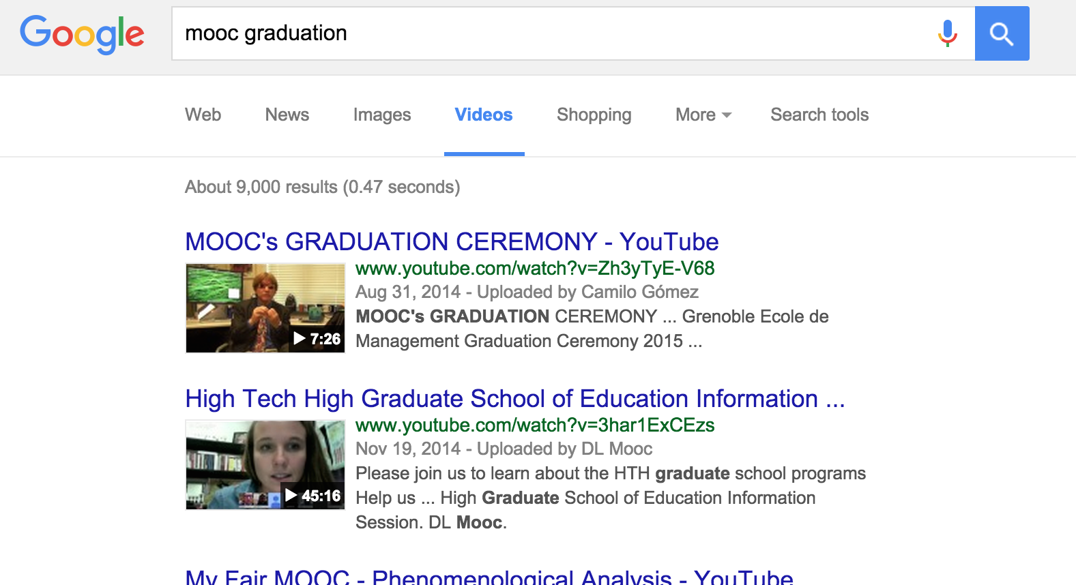
https://www.youtube.com/watch?v=Zh3yTyE-V68

Slide 19
Open Education at scale
Notes:
What is wrong with this picture??

Slide 20
One of these things is not like the others:
www.masteringphysics.com
www.masteringastronomy.com
www.masteringpython.com

Slide 21
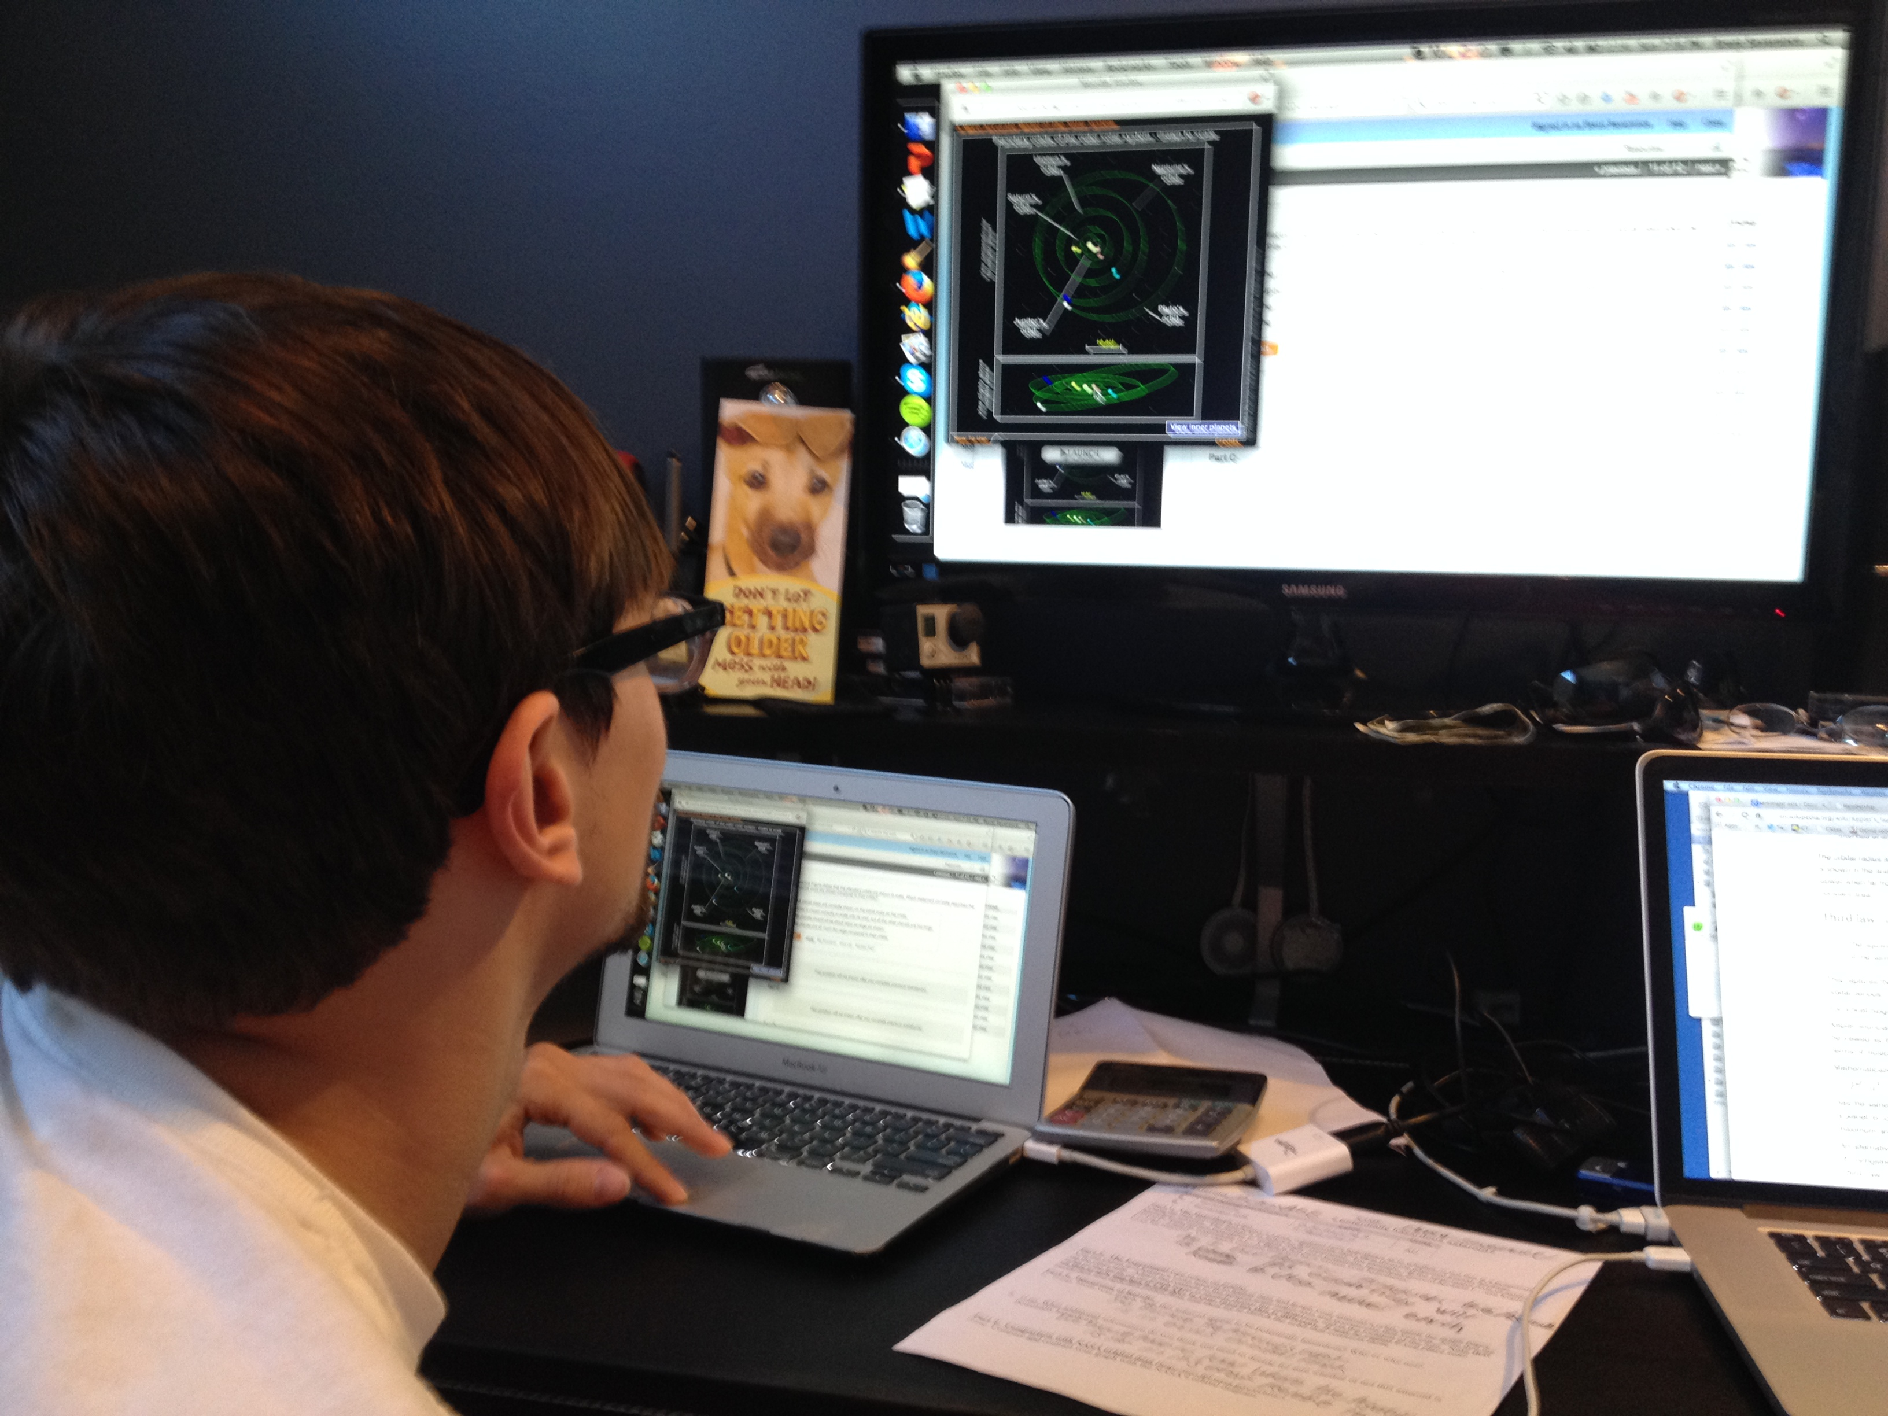

Slide 22
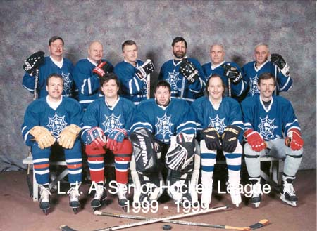
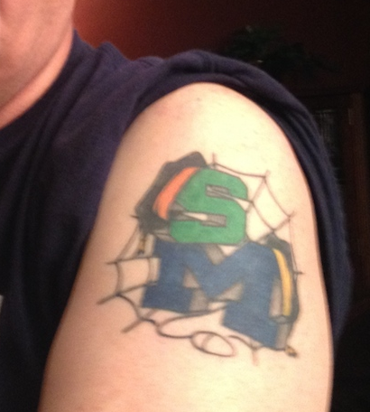

Slide 23
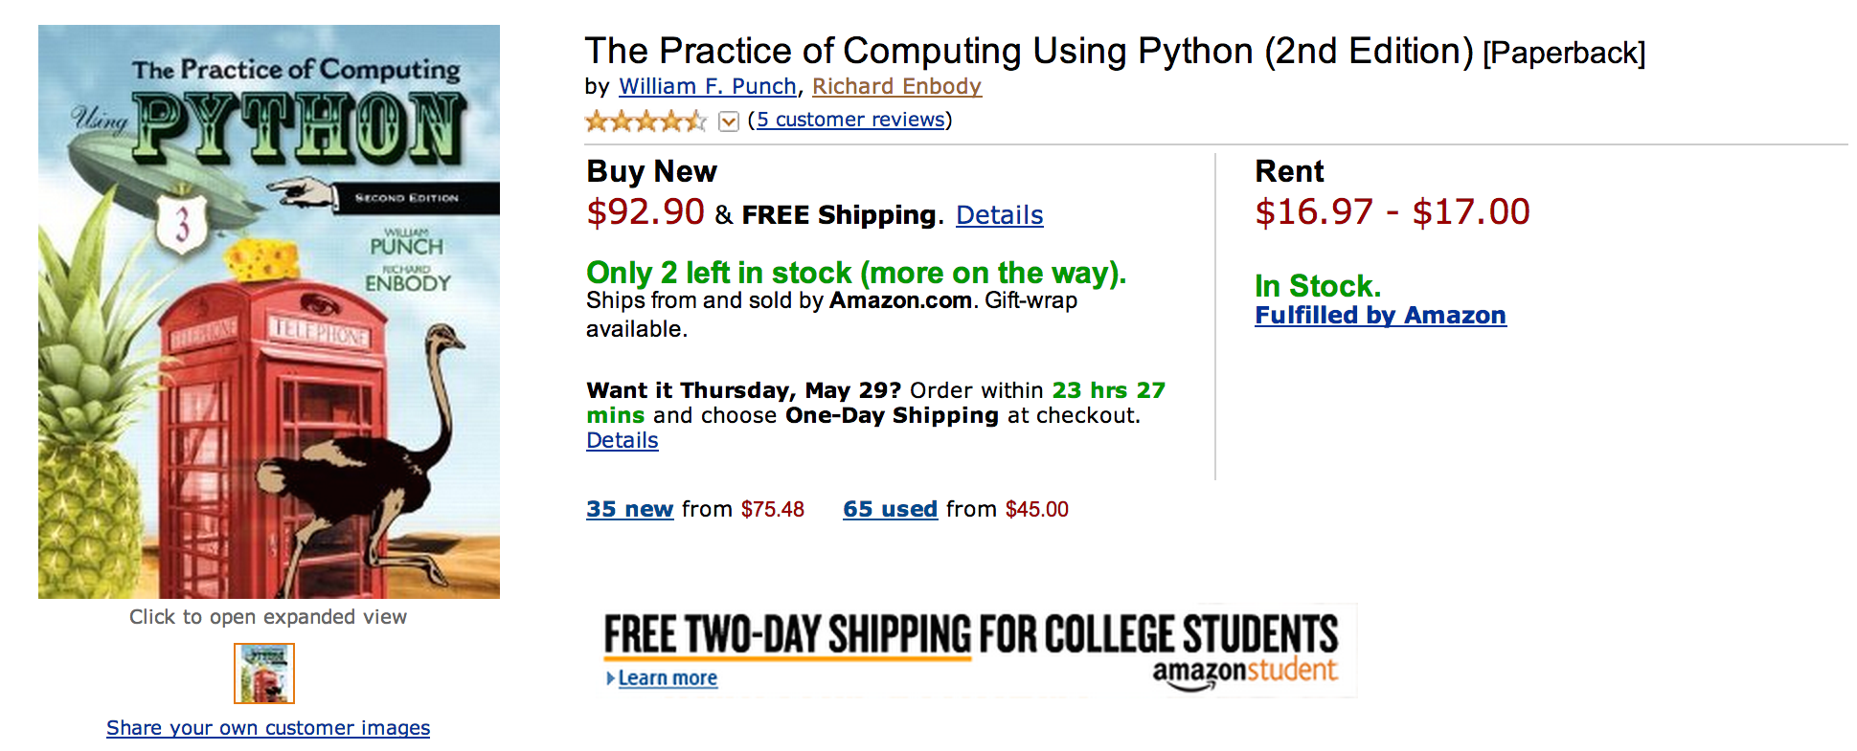
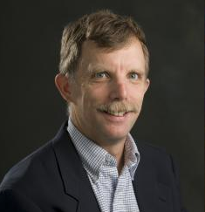


Slide 24
What does $198.35 get you?
Book
Automatic Homework Grading Software
Learning Management System Integration
Instructor Materials
Slides / Solutions Manual / Exams / Course Copy
Instructor Training
3-5 days from notification to full course
Notes:
$65 from Pearson $130 Form bookstore

Slide 25

Teacher Prep
Book
Pearson Value
Proposition
$200
Marketing
Software

Slide 26
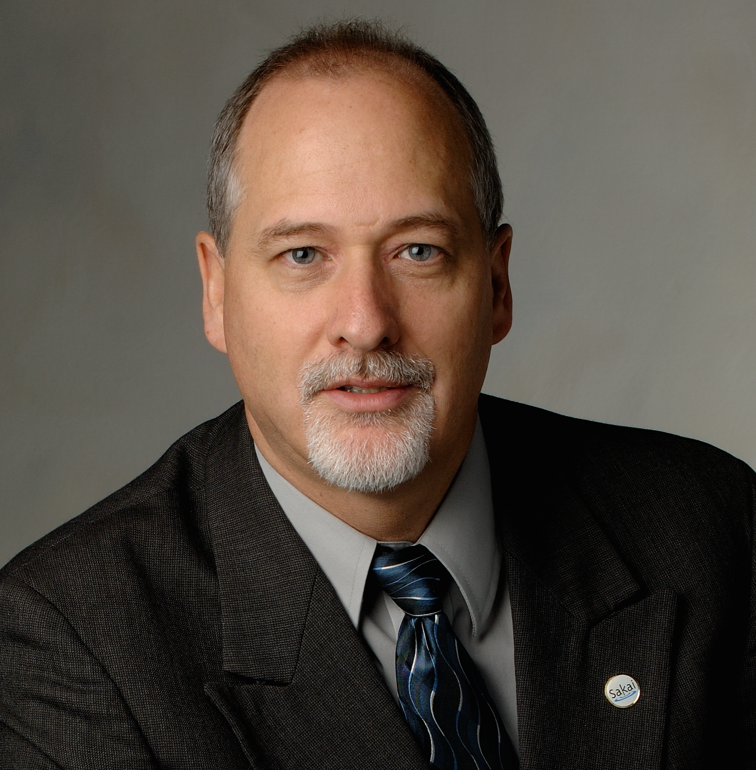
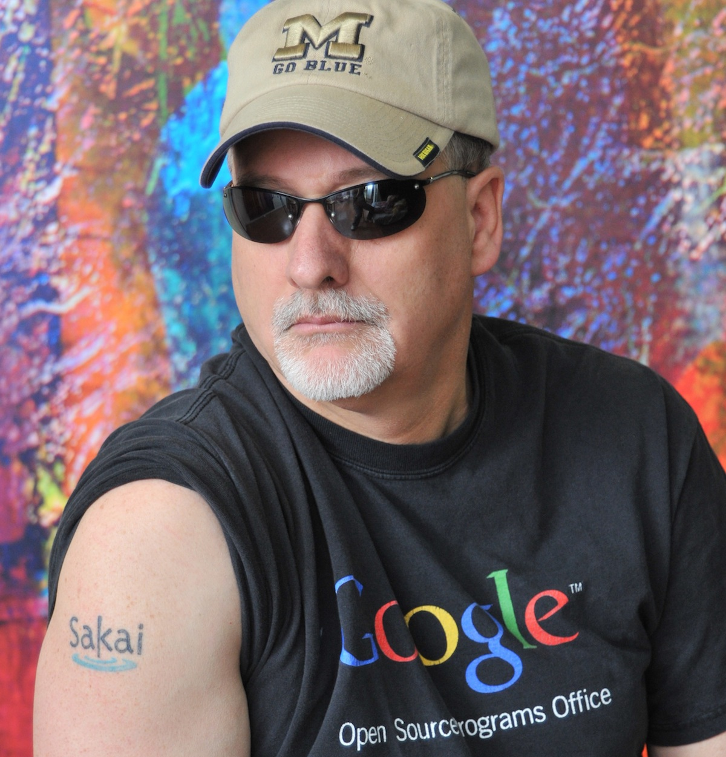



Slide 27
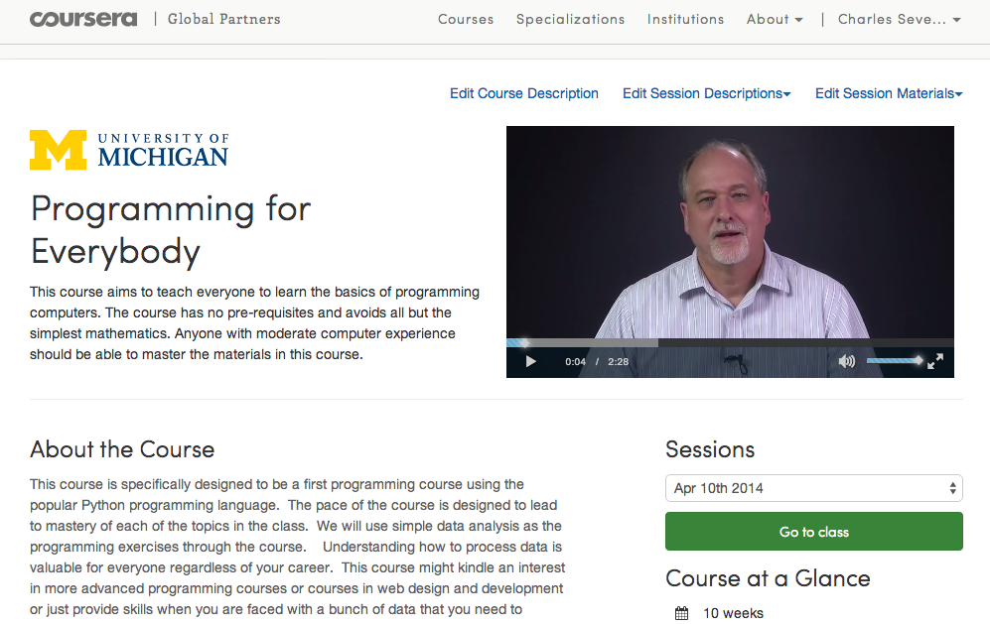

Slide 28
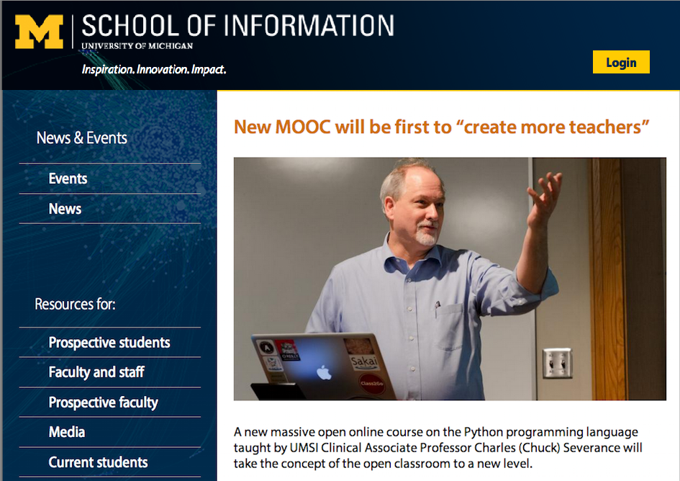

Slide 29
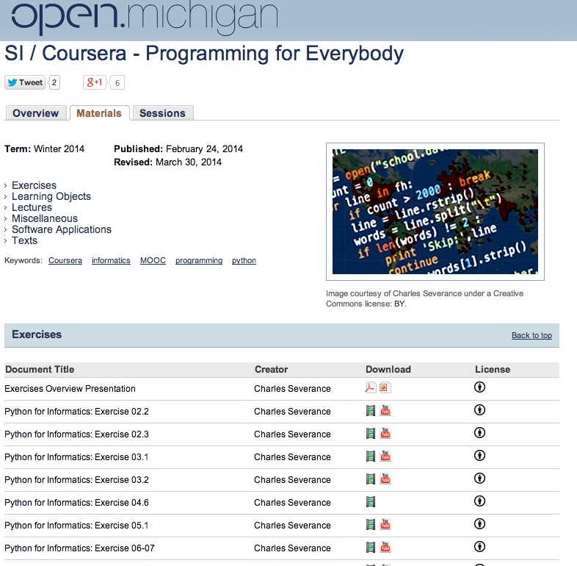

Slide 30
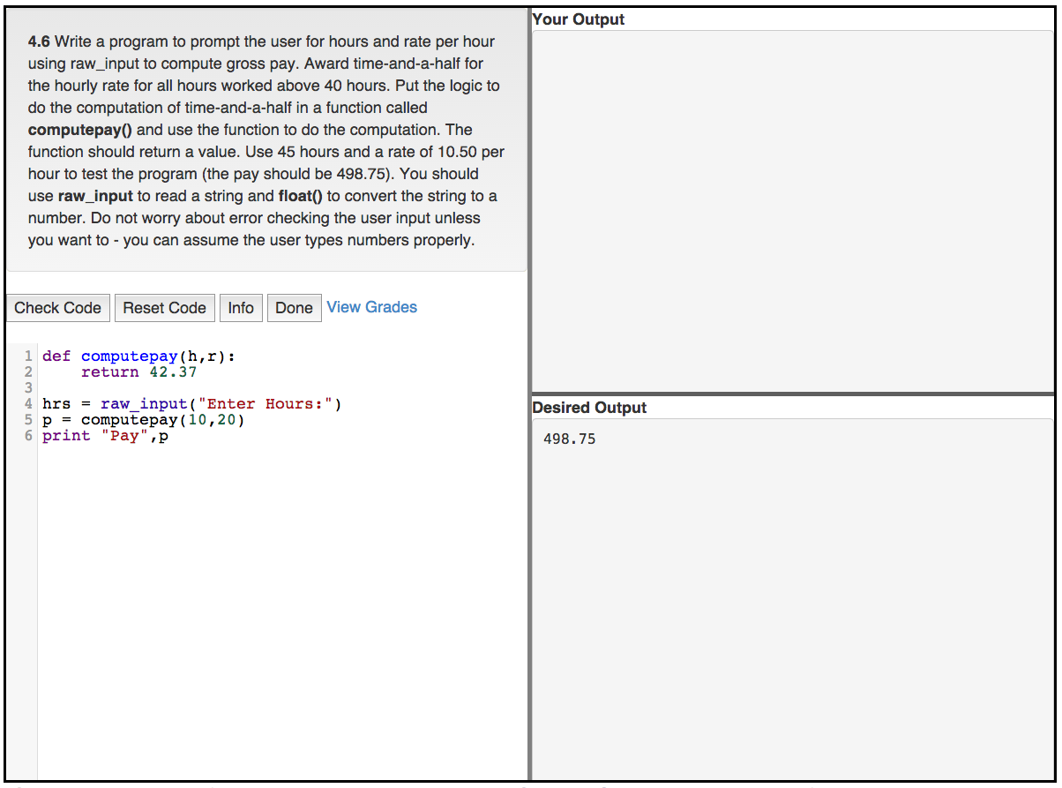


Slide 31
Teacher Prep
Book
Value
Proposition
Software
Free (or $9)
Marketing
Community
Notes:
Will I get

Slide 32
Freely licensed content...

Slide 33
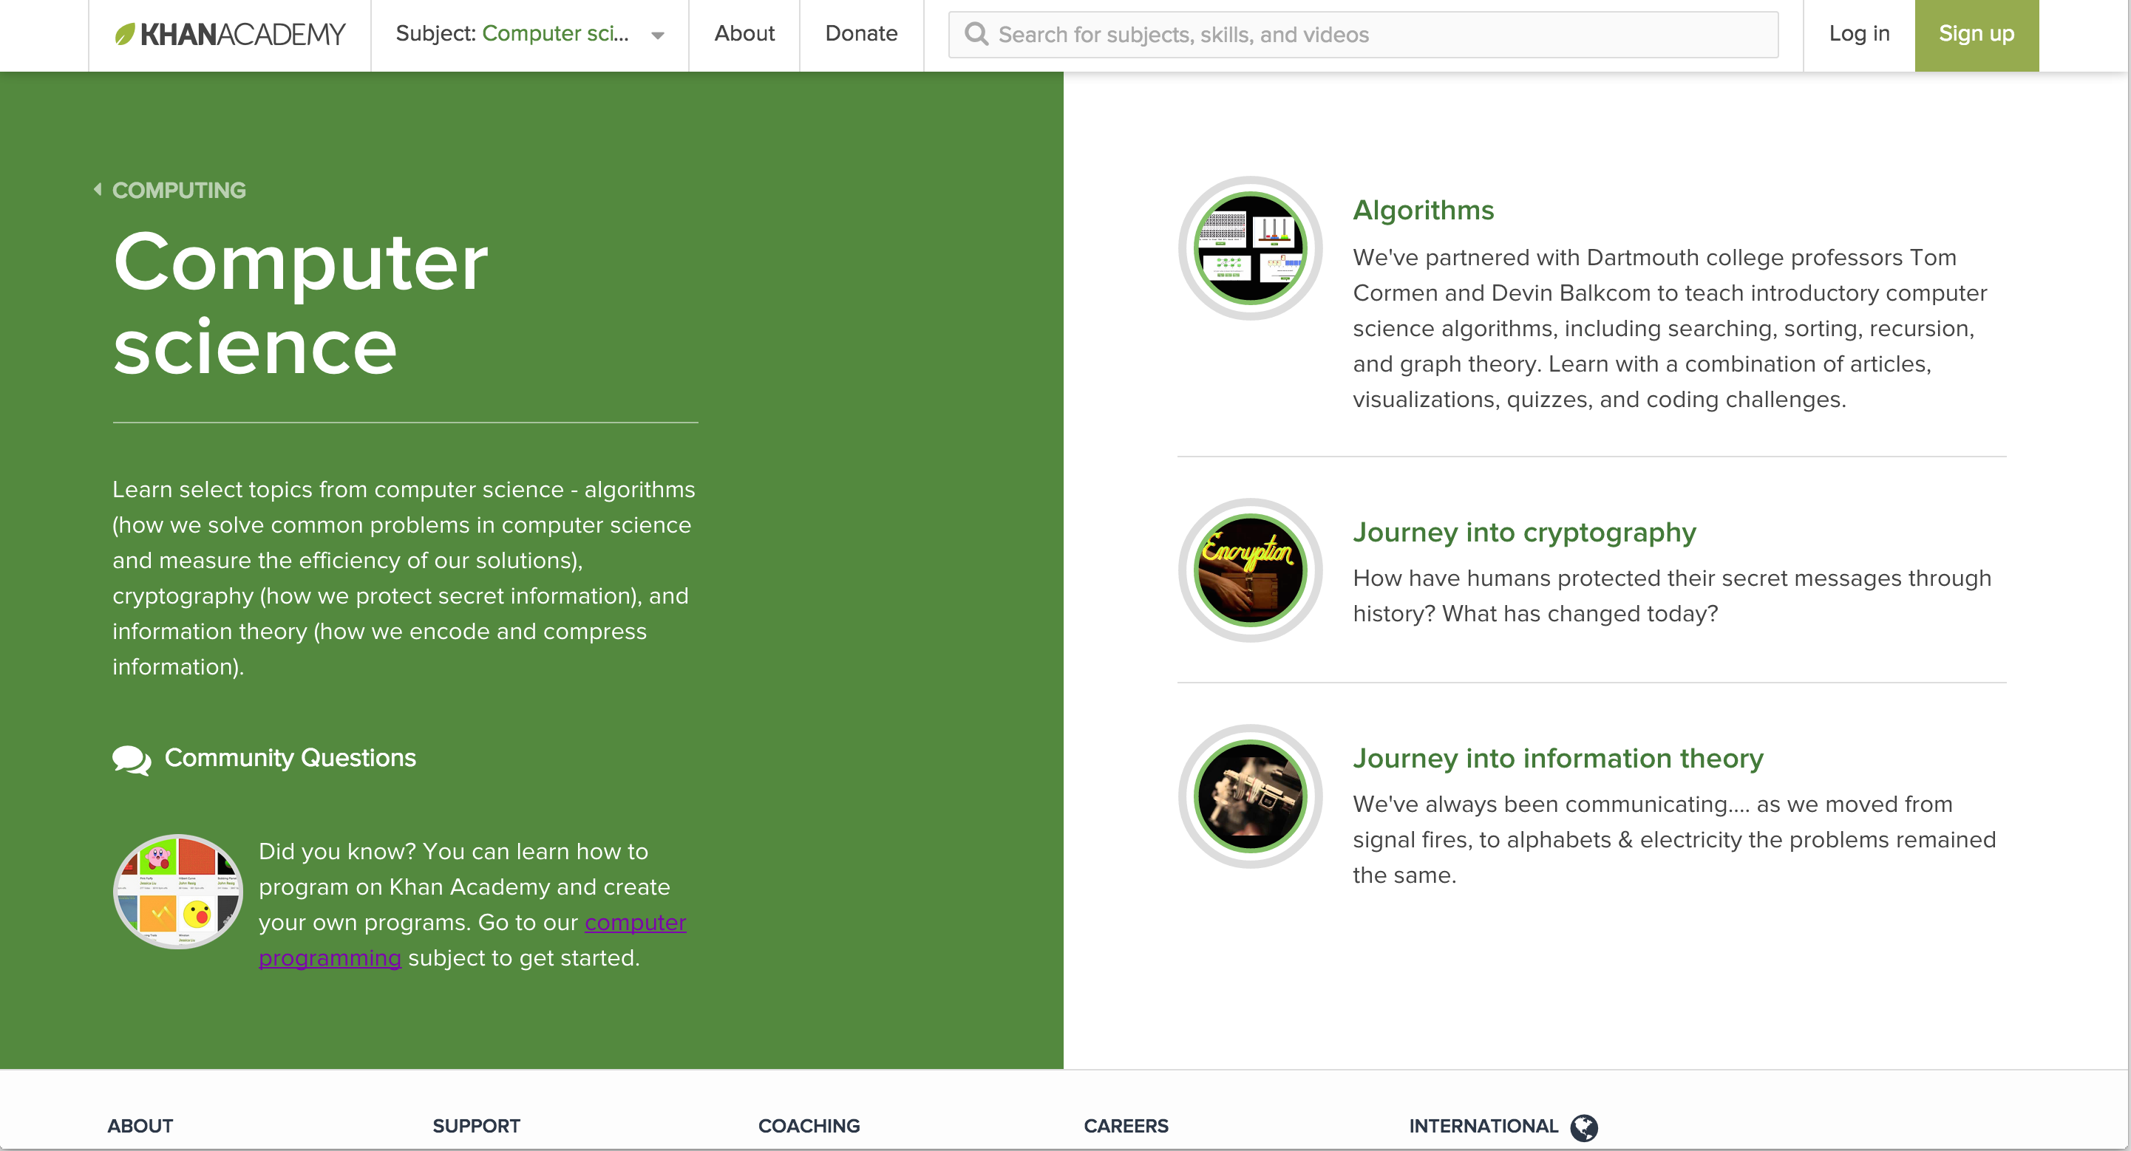

Slide 34
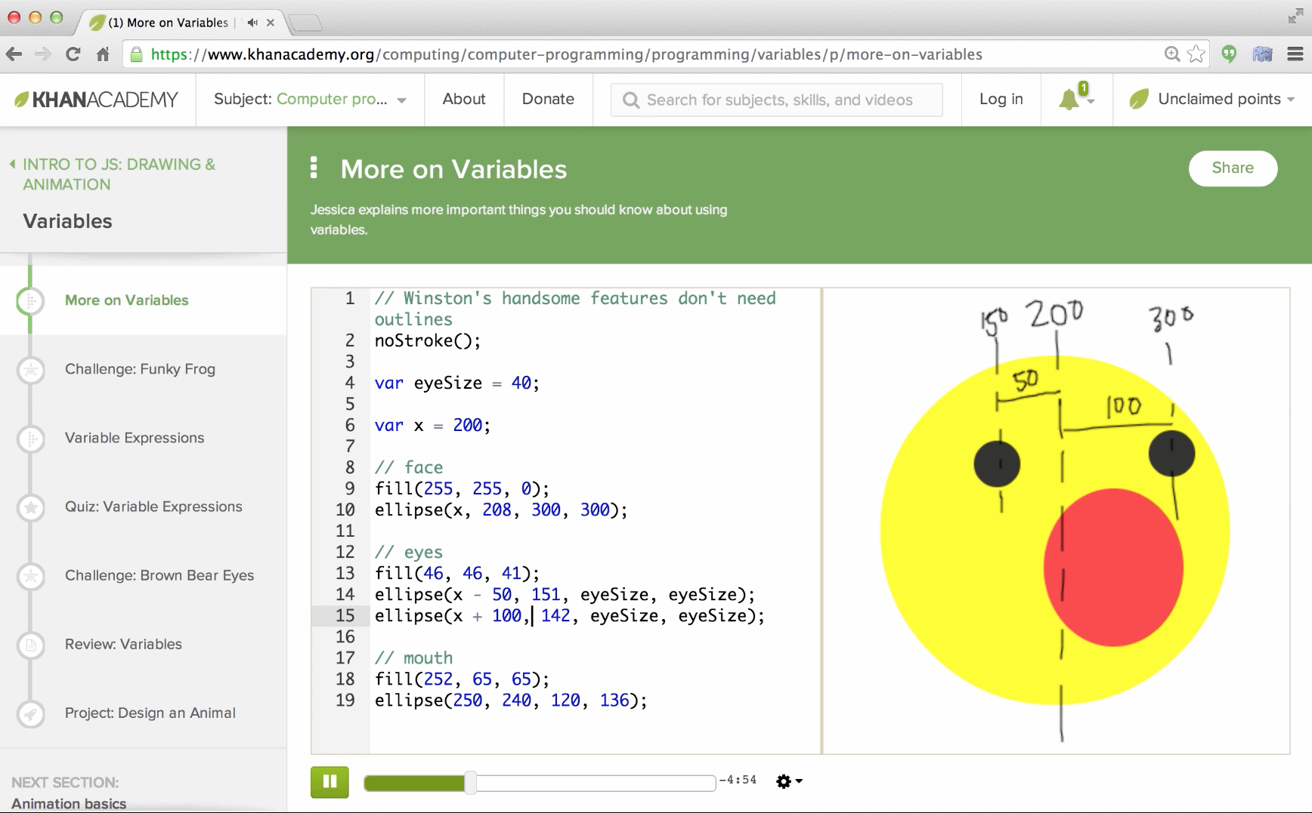
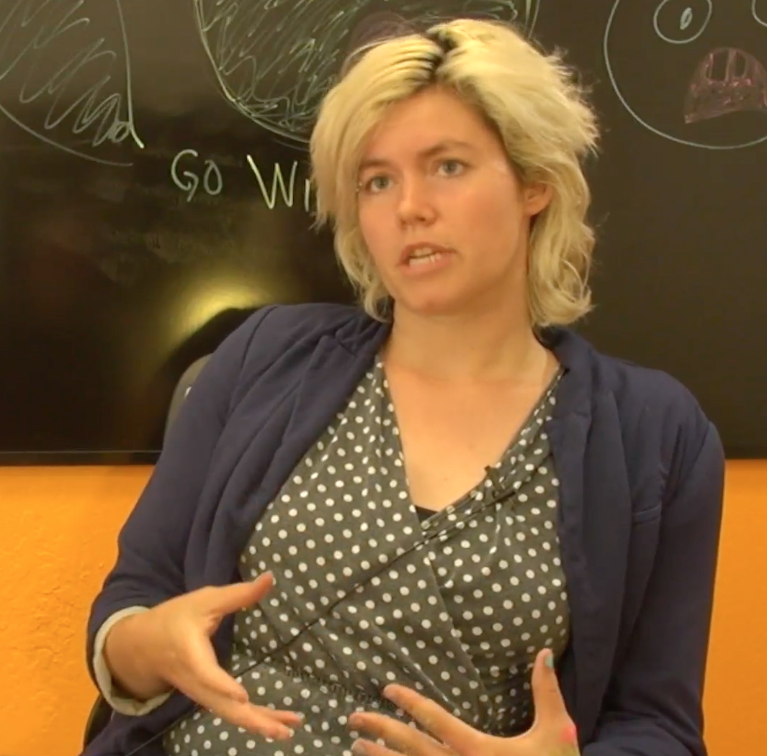
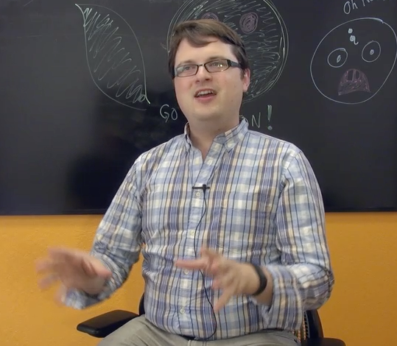
https://www.youtube.com/watch?v=veQaSgjQO2E
Pamela
Fox
John
Resig

Slide 35
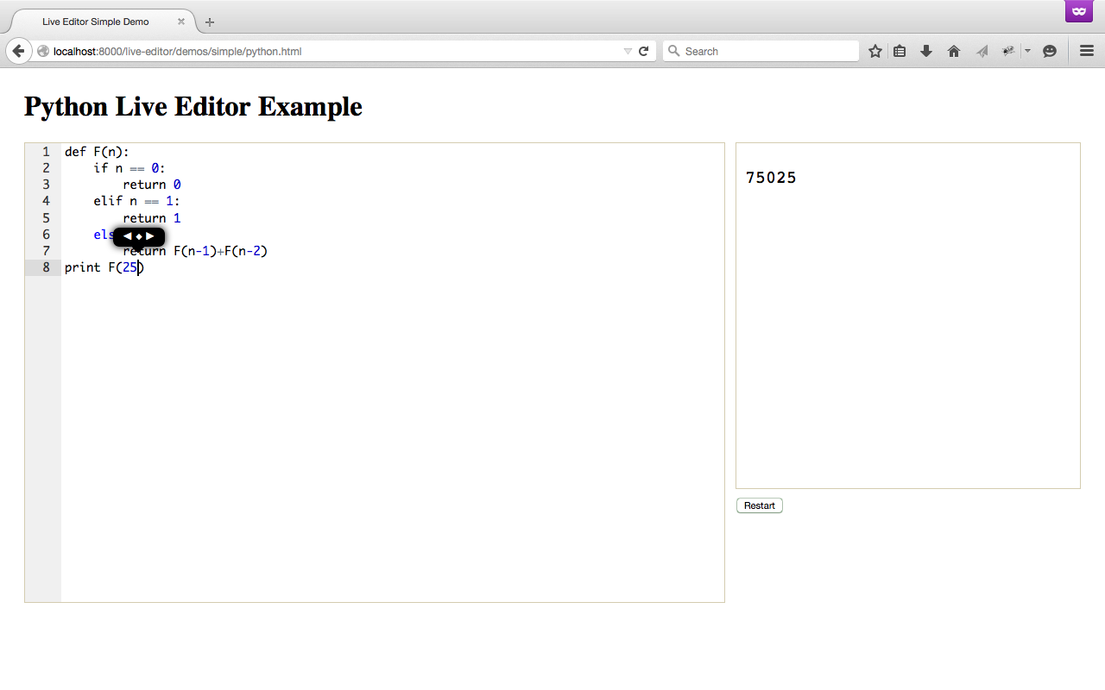
Work In Progress

Slide 36

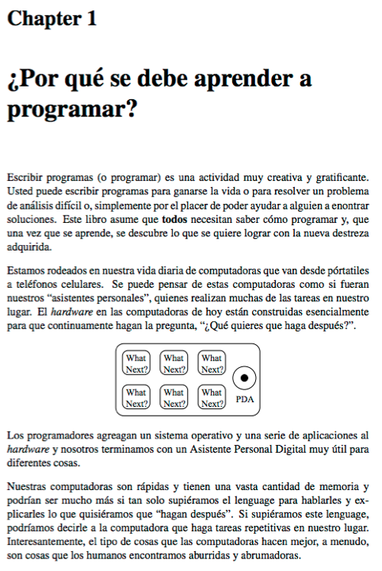
Free Translations
slides.pr4e.org
translate.pr4e.org

Slide 37
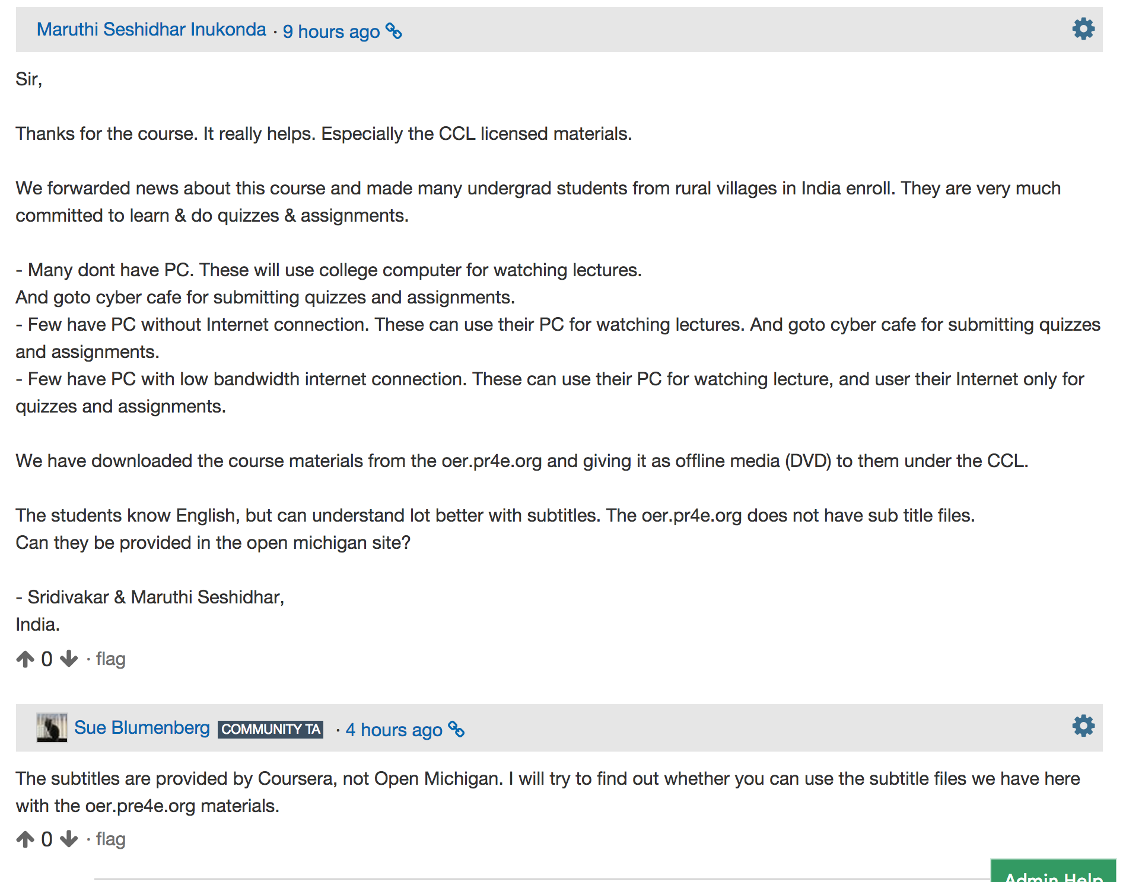

Slide 38
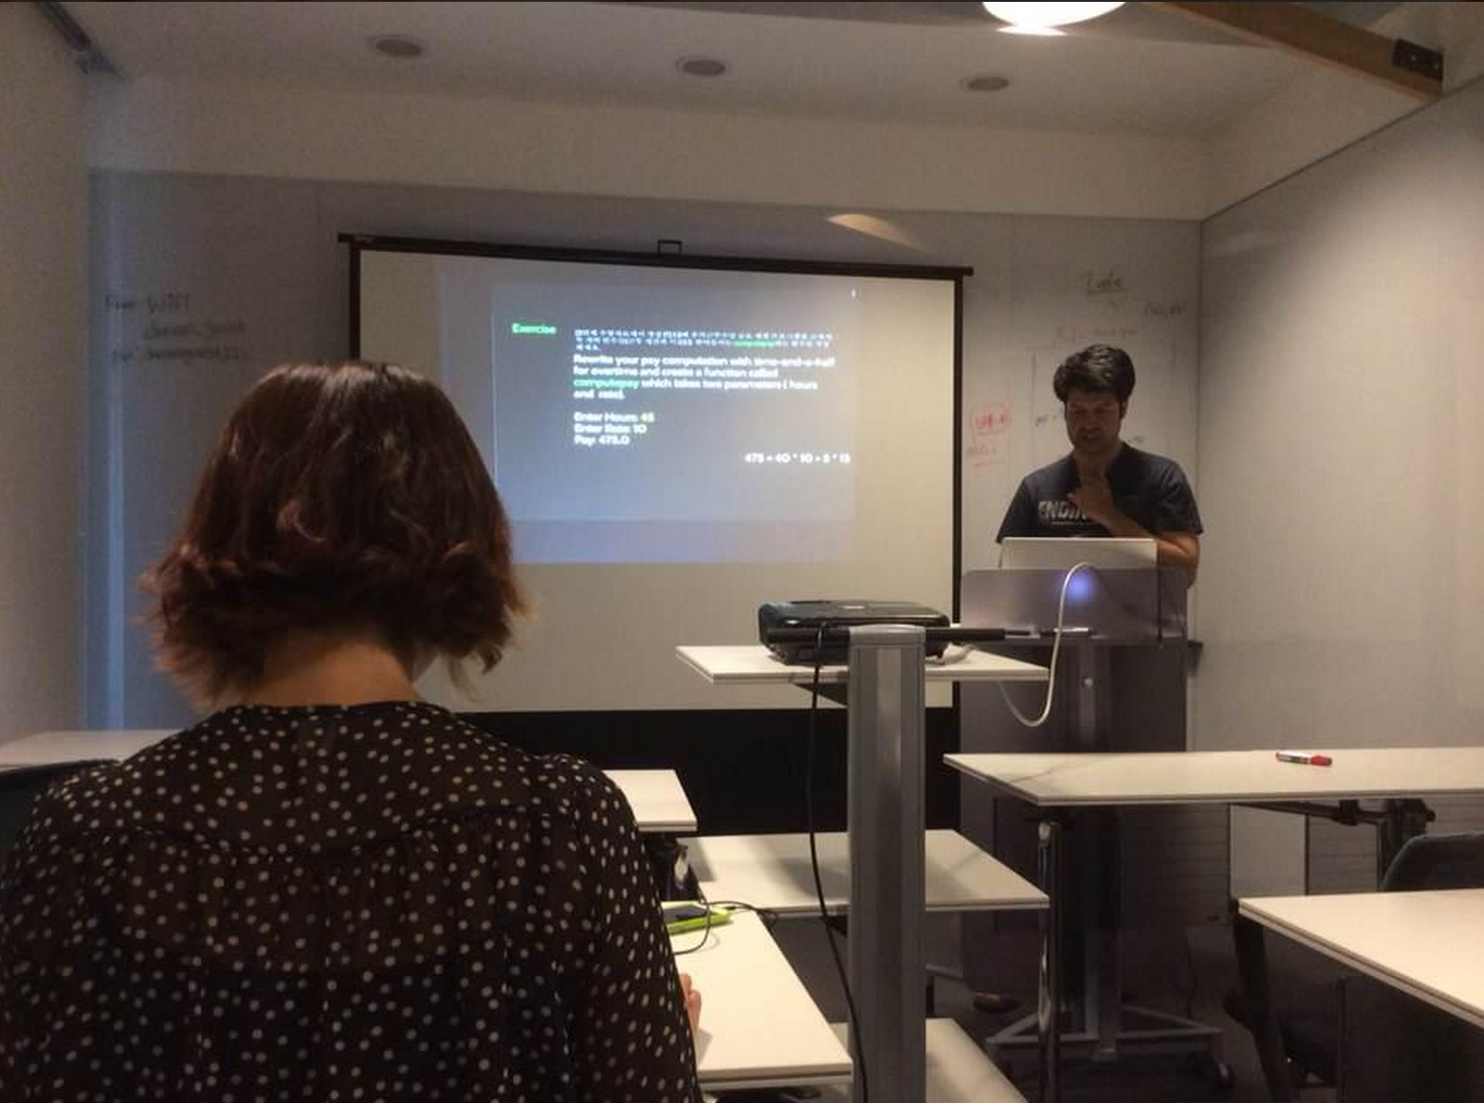
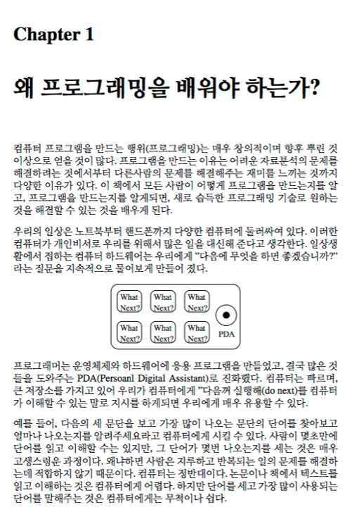
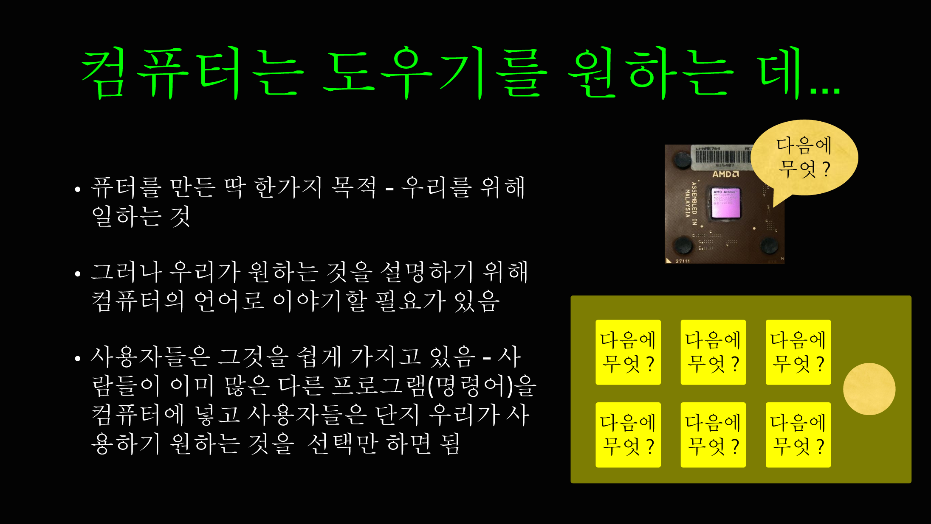


Slide 39




Slide 40
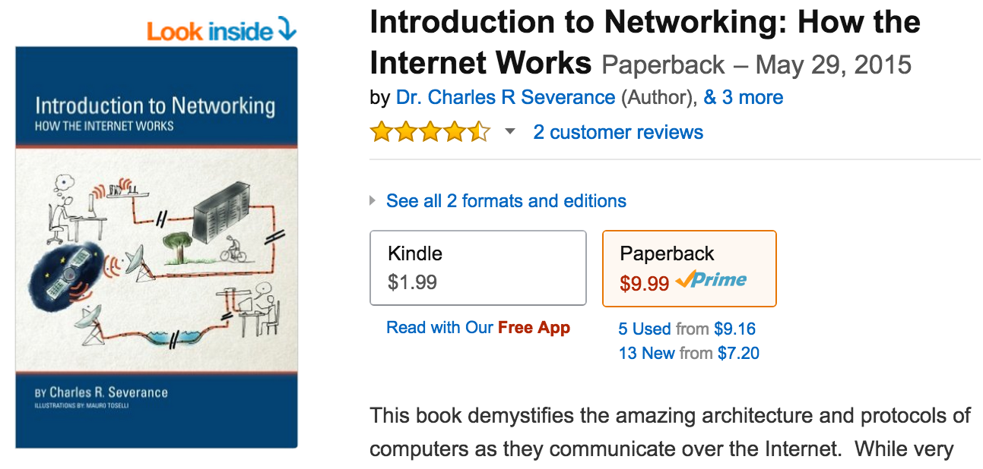
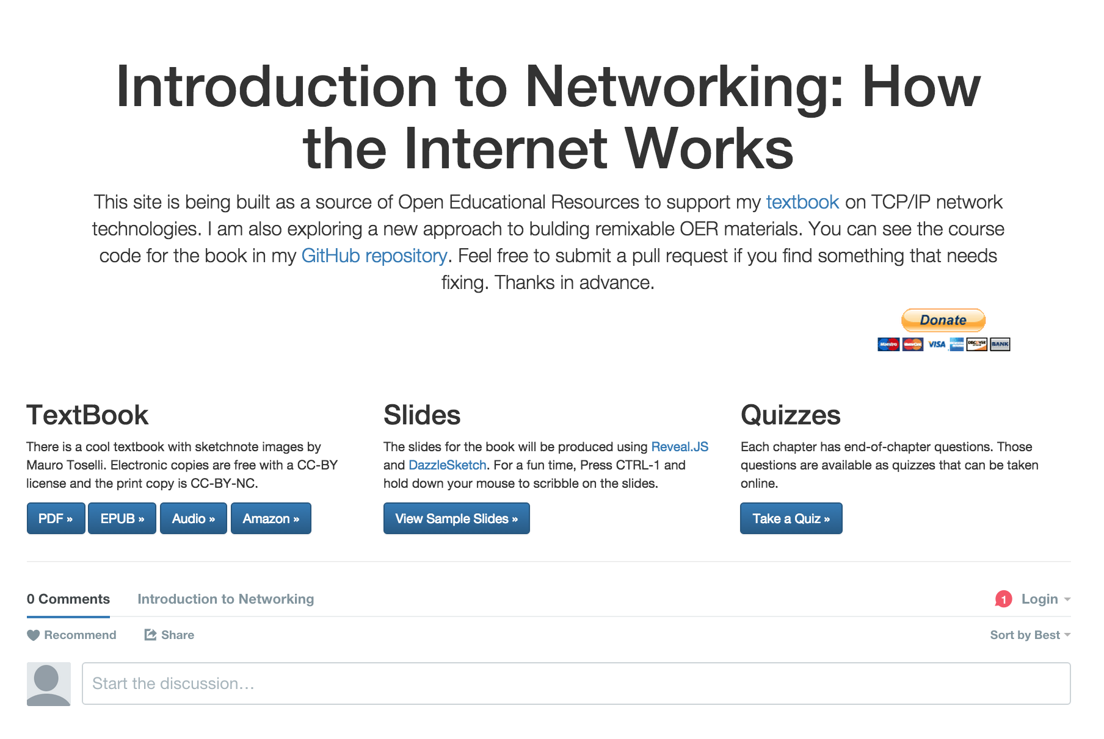
www.net-intro.com

Slide 41
That was one course.

Slide 42
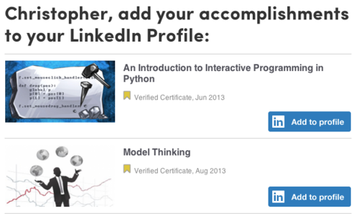
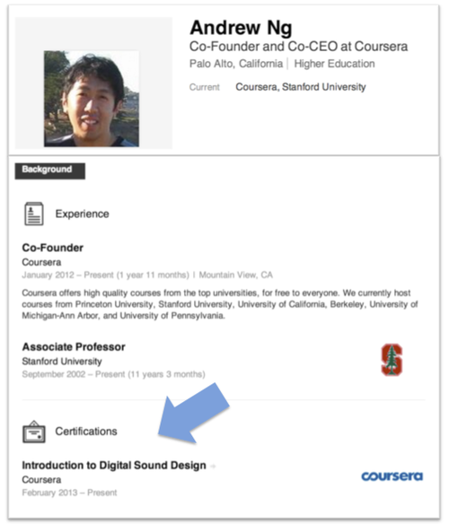
http://blog.coursera.org/post/66959529107/add-coursera-accomplishments-to-your-linkedin

Slide 43

Notes:
80+ Specializations, 400+ classes, aimed at being a maximally certificate value for the student. Completely customizable master's degree for under $2000.

Slide 44


Slide 45
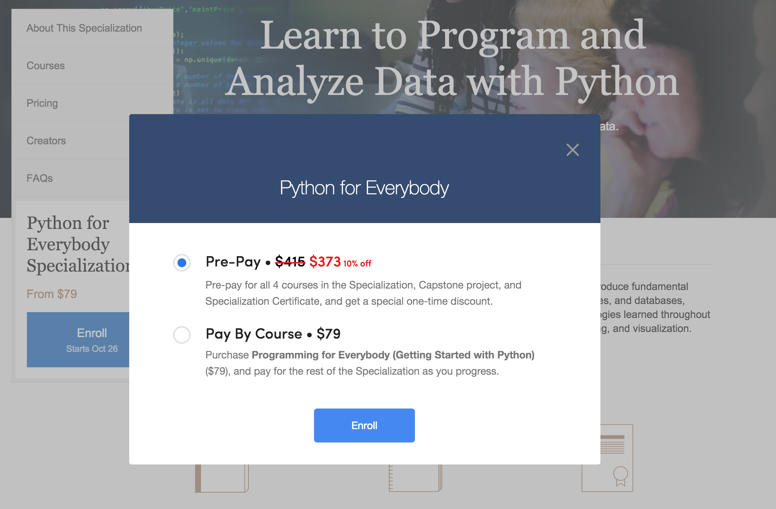

Slide 46
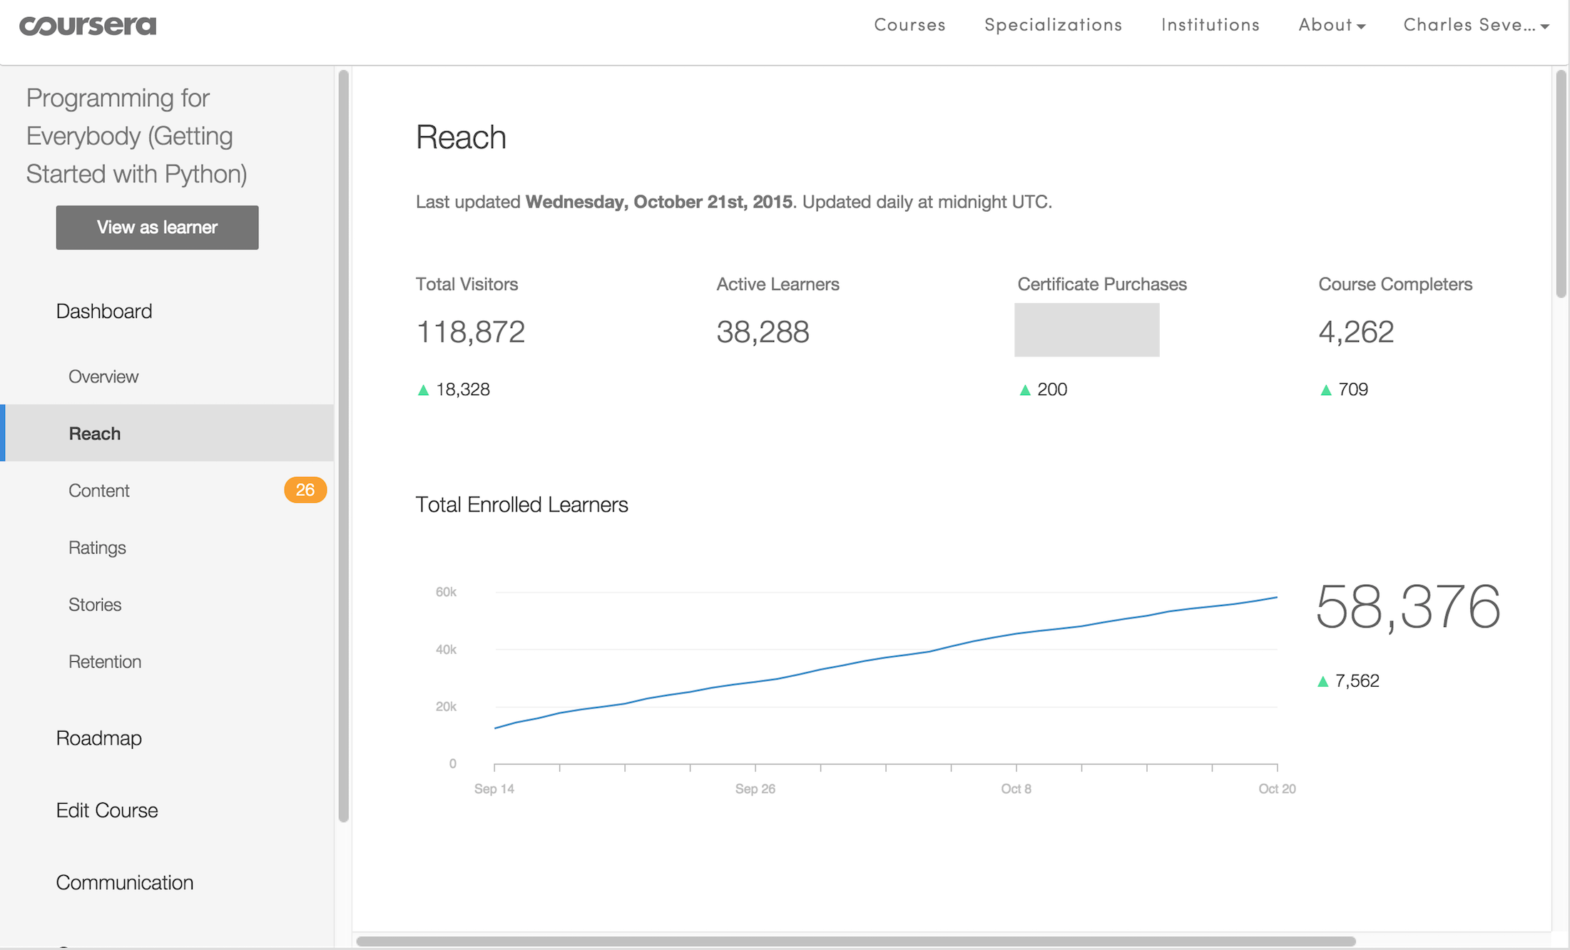
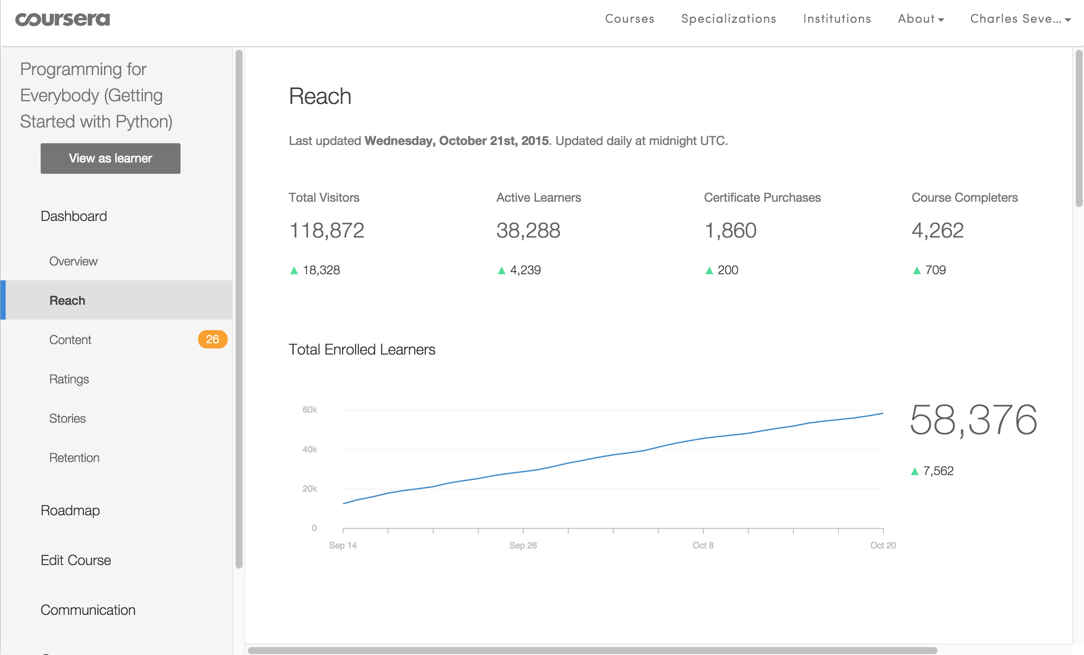

Slide 47
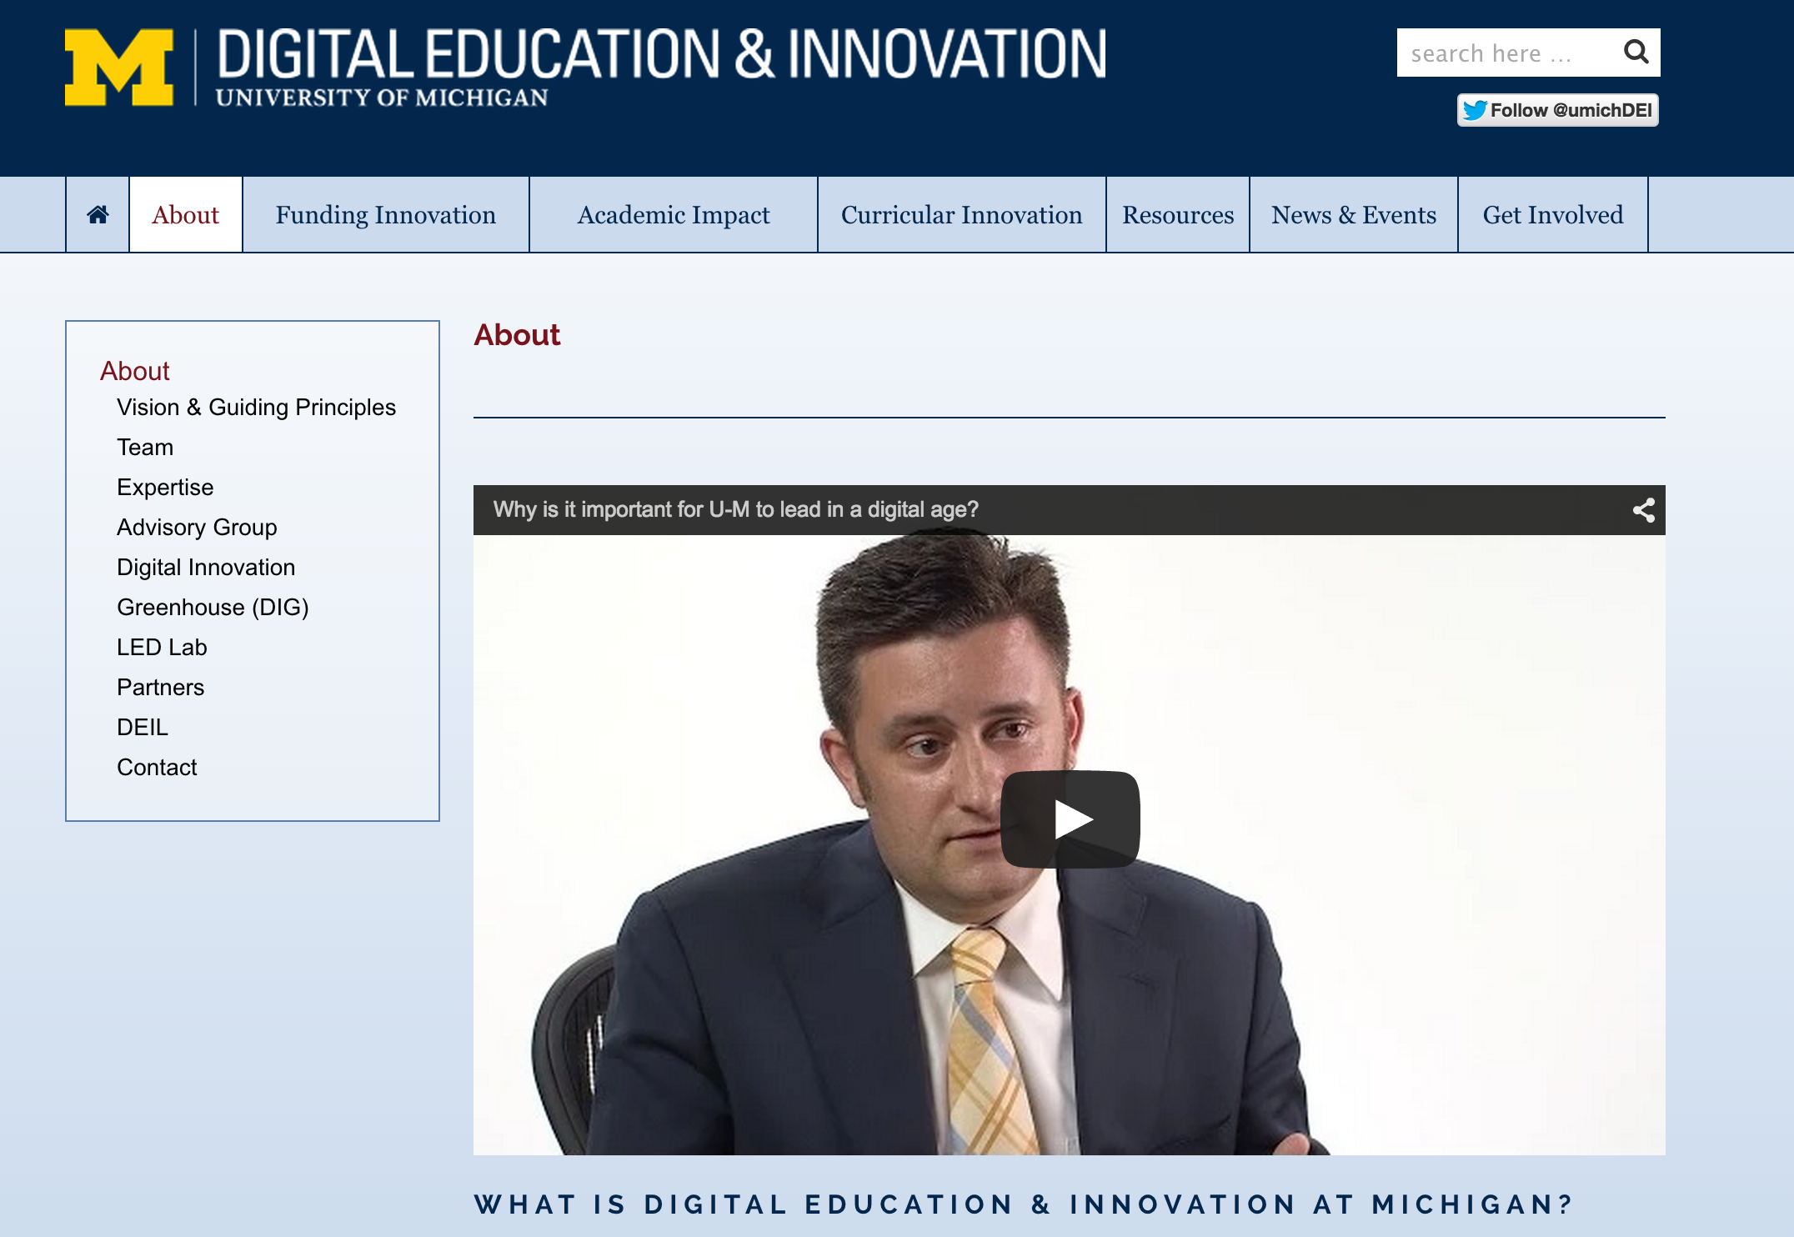
Notes:
It is a responsibility of a public university to lead and define this new space MOOC "Semesters" First week of February, June, and October 30+ courses per year 15 Support Staff Galvanizing education research on campus Learning Analytics Pedagogy

Slide 48
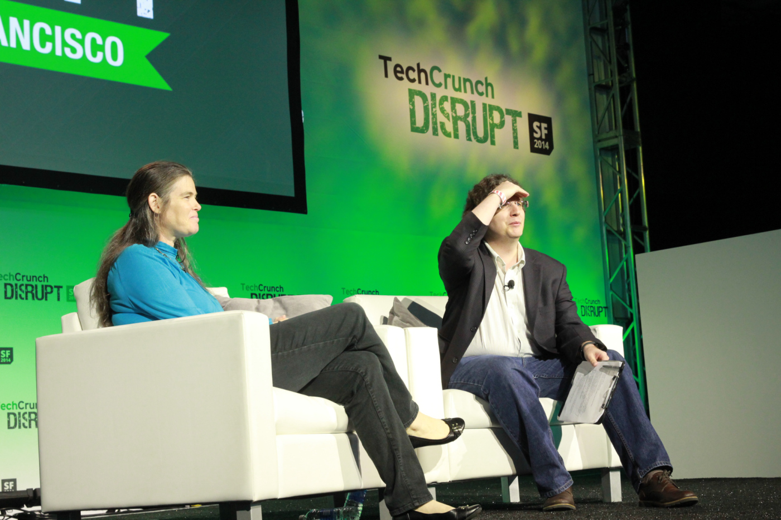


This morning at Disrupt SF, Coursera’s president Daphne Koller pushed back against the notion that her company is a for-profit education company: In her view, Coursera is instead a for-profit technology company.
http://techcrunch.com/2014/09/10/coursera-president-daphne-koller-2014-is-the-year-moocs-will-come-of-age/
Notes:
Market...

Slide 49
